Slide 1
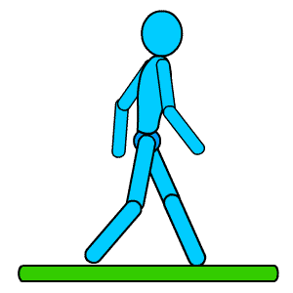



Preparing for Your Colorectal Surgery
Start exercising. Walk ½ mile a day.
Smokers-STOP SMOKING for at least 72 hours before surgery.
Start 1 Multivitamin daily and Eat a High Protein diet for 7 days before surgery.
Stop Alcohol at least 7 days before surgery.
Keep your Preadmission Testing Hospital Appointment.
Your surgeon or nurse will instruct you on which home medications to take the morning of surgery. If you are on chronic pain medications (including pain patches) continue those as ordered until admission.
Follow your surgeon’s orders for Bowel Prep and Pre-Surgical Skin Cleansing.
Clear liquids are encouraged until 2 hours before surgery. Clear liquids include apple, cranberry or grape juice, Kool Aid or Soft Drinks for non- diabetic patients. Diabetic patients can have Sugar free Kool Aid, Diet Soft Drinks, G2 or Powerade ZERO.
NON DIABETIC PATIENTS MUST FINISH DRINKING 32 OZ. OF GATORADE OR POWERADE 2 HOURS PRIOR TO YOUR SURGERY START TIME. DIABETIC PATIENTS MUST FINISH DRINKING 32 OZ. OF G2 OR POWERADE ZERO 2 HOURS PRIOR TO YOUR SURGERY START TIME.
NOT FOLLOWING THESE INSTRUCTIONS WILL RESULT IN A DELAY IN SURGERY START TIME.

